Slide 1
All models are wrong, but some are useful...
An attempt to predict high cholesterol via
multiple linear regressions

Slide 2
All models are wrong, but some are useful... maybe not this one
An attempt to predict high cholesterol via
multiple linear regressions

Slide 3
Table of Contents:
Problem
Investigation
Results
Next Steps

Slide 4
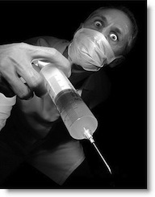
The problem: People hate needles
Context
Context
Problem statement
Company
Cholesterol is a waxy substance found in our blood. High LDL cholesterol increases your risk of heart disease, heart attacks, & stroke. High cholesterol has no symptoms, and has been called a silent killer
Can we predict high LDL (“bad”) Cholesterol based on self- measurable metrics that don’t involve needles or require visiting a doctor’s office?

Slide 5

A topic that hits close to home...

Slide 6
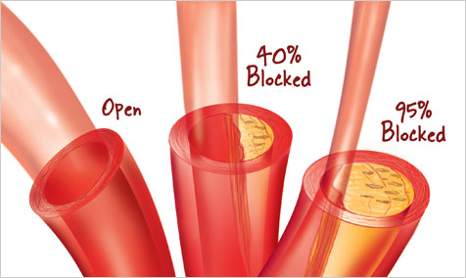
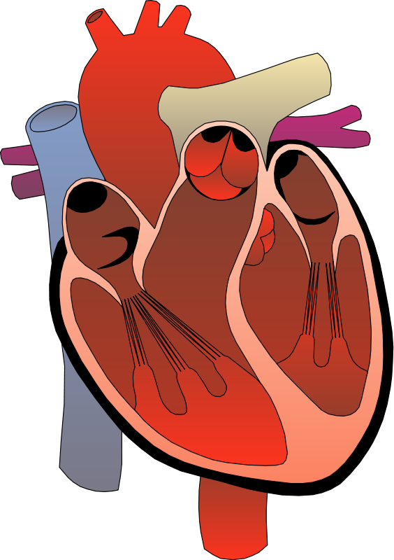
A topic that hits close to home...

Slide 7
Table of Contents:
Problem
Investigation
Results
Next Steps

Slide 8
Risk Factors include...
Poor Diet
Gender
Lack of Exercise
Obesity / Large waist
Lifestyle
Demo-
graphic
Race
Age
Smoking
Stress
Diabetes

Slide 9

Risk Factors include...
Poor Diet
Gender
Lack of Exercise
Obesity / Large waist
Lifestyle
Demo-
graphic
Genetics
Race
Age
Smoking
Stress
Diabetes

Slide 10
National Health & Nutrition Examination Survey
Saturated Fat
Alcohol
Salt
Poor Diet
Lack of Exercise
Days per week with exercise
Waist circumference
BMI
Obesity / Large waist
Lifestyle
Smoking
Cigarettes in last 30 days
Past cigarette consumption
Income to Poverty Ratio
Blood Pressure
Marriage?
Stress

Slide 11
National Health & Nutrition Examination Survey
Gender
Gender
Age
Demo-
graphic
Race
Age
Race
US Citizen?
Diabetes
Diagnosed y/n
Age when diagnosed

Slide 12
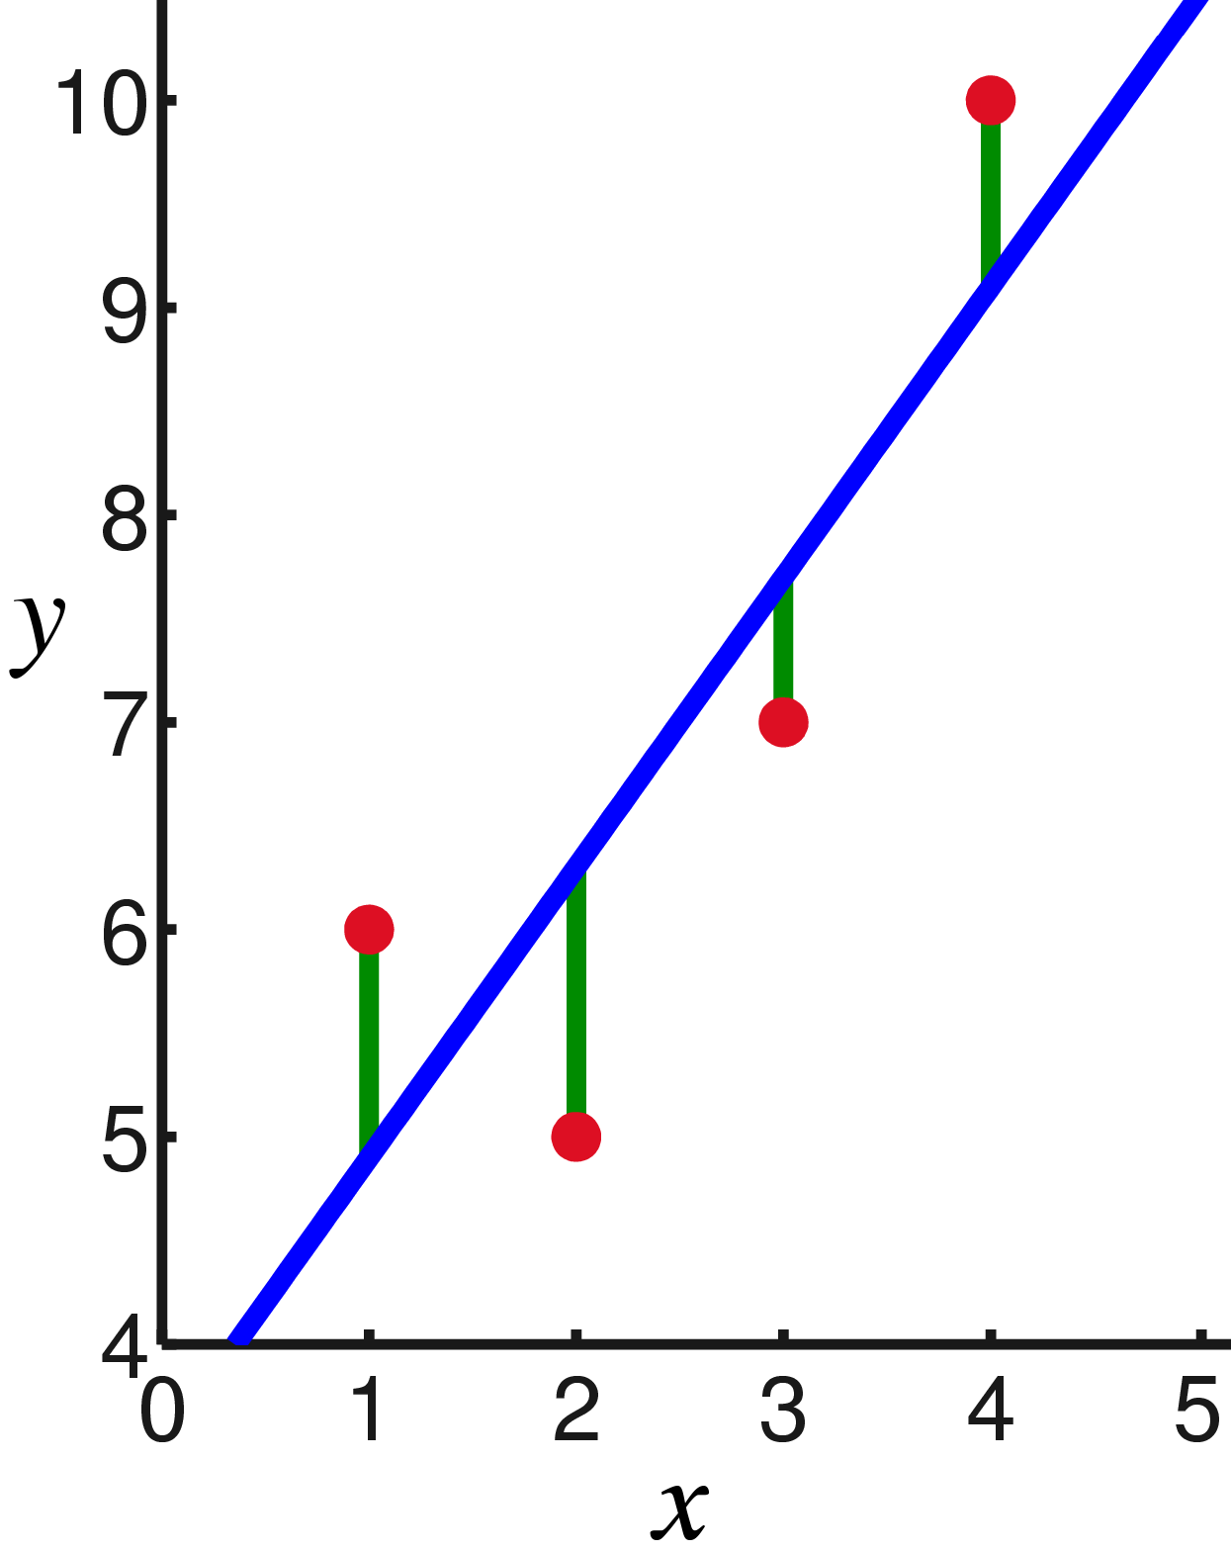
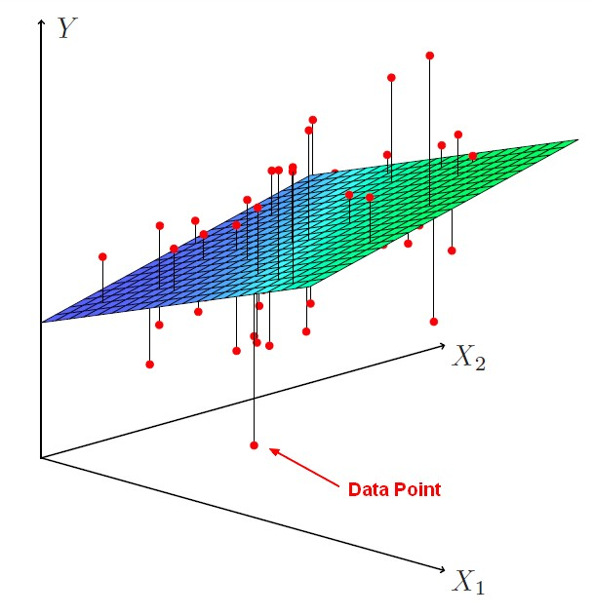
Linear Regression: Ridge Regression
Goal: Minimize errors (SSE) and maximize predictive power

Slide 13
Process
MSE tests showed there was no need to generate higher order polynomials
2431 Participants 17 Predictor variables Split into “train” and “test”
“Test” how the model performs
Gather and split data
Transform variables
Check for interactions
Ridge linear regression
Interpret results
Several variables were non-normal, so these needed transforming¹
“Train” the model with regression technique that reduces both in and out of sample errors
Used BoxCox transformation

Slide 14
Table of Contents:
Problem
Investigation
Results
Next Steps

Slide 15
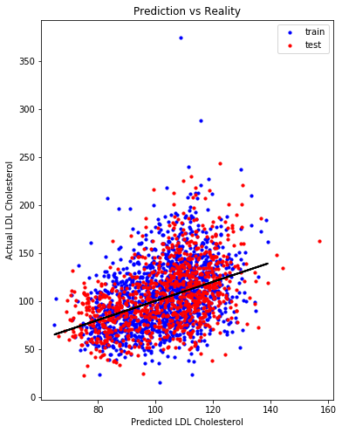
Test R²: 0.108
Difference from train R²: 0.038
Test SSE: 3.04
Difference from train SSE 1.36
In other words, we expect our model could account for ~11% of variability seen in LDL Cholesterol

Slide 16
Test R²: 0.108
Difference from train R²: 0.038
Test SSE: 3.04
Difference from train SSE 1.36
In other words, we expect our model could account for ~11% of variability seen in LDL Cholesterol

Slide 17
Table of Contents:
Problem
Investigation
Results
Next Steps

Slide 18
Next Steps
Company
Plenty of room for improvement, but linear regression may not be the right tool for the job
Ways we could improve linear regression:
More Data - multiple years
Smarter feature generation from lifestyle survey (e.g. exercise)
Transformations of data with 0’s (e.g. smoking, alcohol)

